Slide 1

A Data Analysis Project
Dengue Fever: WorldWide Health Threat
By Iffat Firozy Rimi

Slide 2
Index
01.
02.
03.
04.
About
Let’s talk about the problem and dataset
Analysis
We’ll analyze some visualization
Machine Learning
Predict dengue cases using machine learning
Conclusion and Future Work
We’ll see, the key findings of our projects

Slide 3
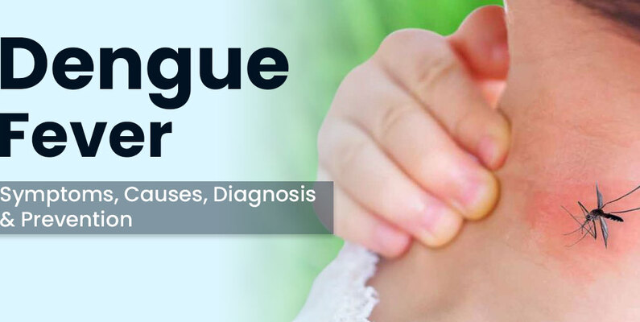
About Dengue Fever: WorldWide Health Threat
The dataset titled "Dengue Fever - Worldwide-Updated" on Kaggle includes detailed information on dengue cases reported globally. It contains data on various factors such as the date of fever onset, dwelling place, duration of fever, temperature, white blood cell count, and several symptoms like severe headache, pain behind the eyes, joint/muscle aches, metallic taste in the mouth, appetite loss, abdominal pain, nausea/vomiting, and diarrhea. The dataset also includes hematological parameters like hemoglobin, hematocrit, and platelet count, and indicates whether the case was confirmed as dengue or not.

Slide 4
Details of the DATASET
Total Column - 18
820 Entries
Have some missing values
Data Types: float, int, object

Slide 5
02.
Analysis
Let’s see some visualizations

Slide 6
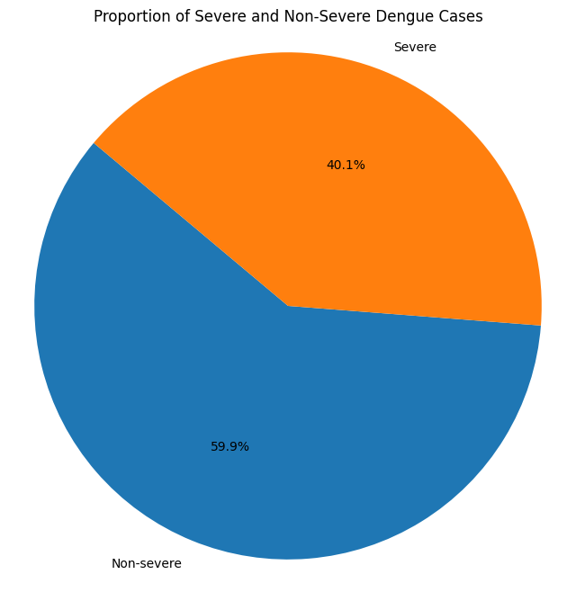
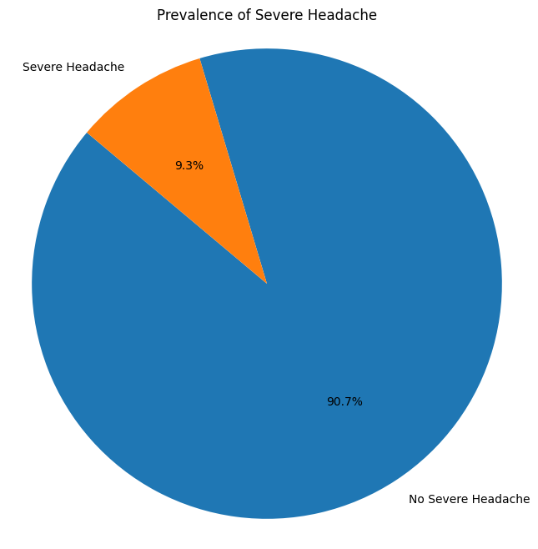
Pie chart
In first chart we can see 59.9% of dengue cases are severe and 40.1% are non-severe. But in the second, It indicates that 9.3% of the population suffers from severe headaches, while 90.7% do not.

Slide 7
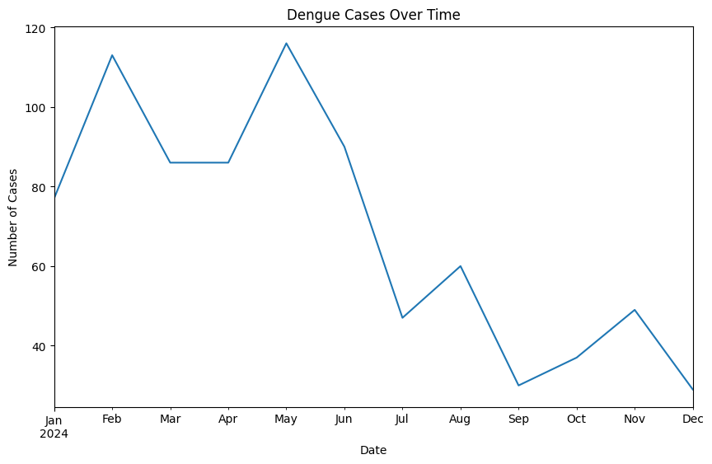
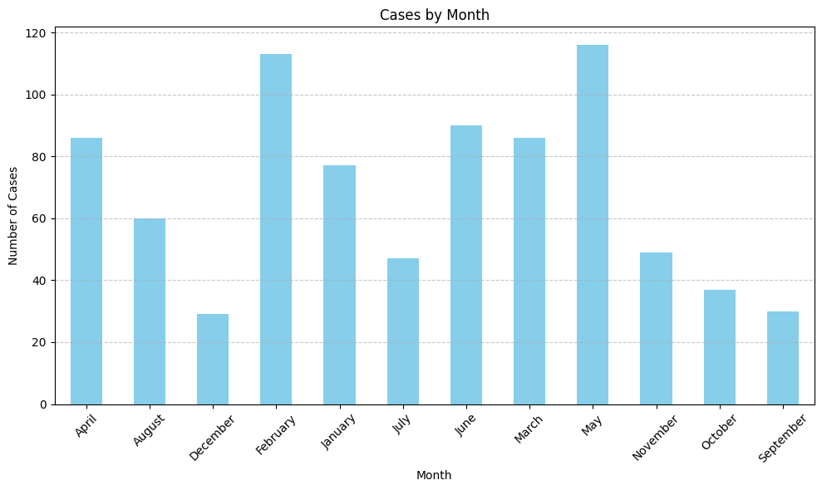
Dengue Cases Over time
The graph shows a trend in the number of dengue cases throughout 2024. It starts with a relatively low number of cases in January and February, then increases gradually until May
The graph shows a seasonal pattern in the number of dengue fever cases. The number of cases is lowest in November and December, and highest in June and July. This pattern is likely due to changes in temperature and rainfall, which can affect the mosquito populations that transmit dengue fever.

Slide 8
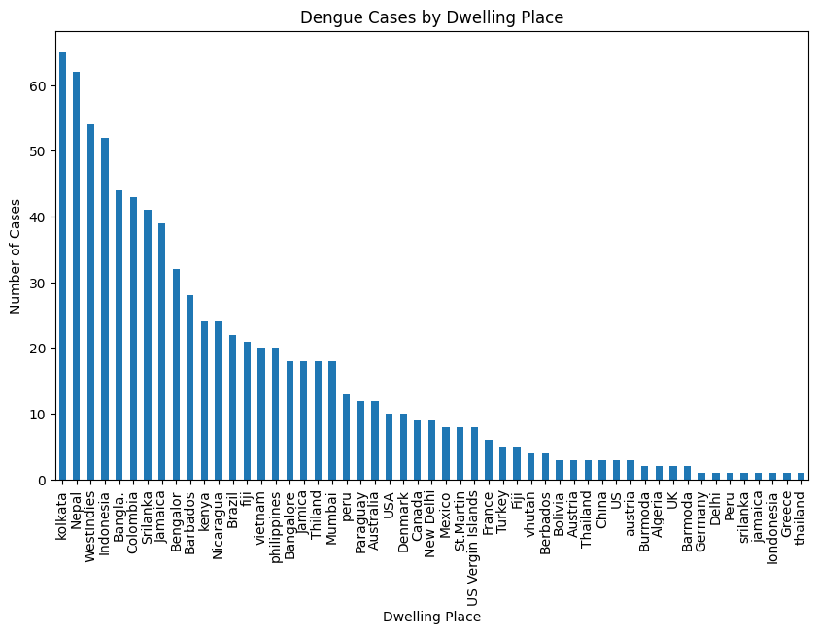
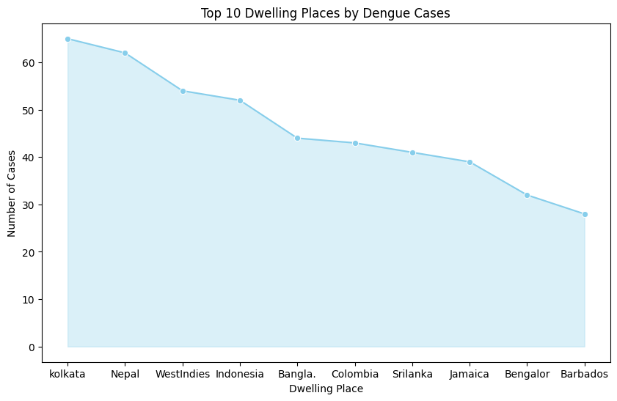
Dengue cases by Place
It shows the number of dengue fever cases in various countries. The graph shows that Kolkata, India has the highest number of dengue cases, followed by Nepal and Indonesia.

Slide 9
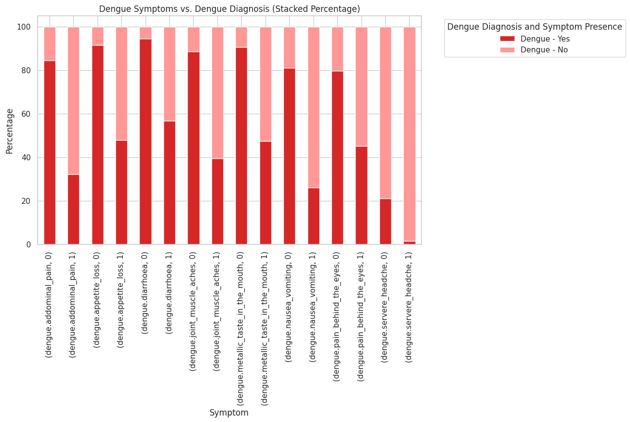

The relationship between symptoms and dengue diagnosis
The graph suggests that a positive diagnosis of dengue fever is more likely for people who experience multiple dengue symptoms.
Here are some additional details that can be gleaned from the graph:
Joint and muscle aches is the most common symptom among those with a dengue diagnosis, with 100% of people with dengue fever and joint and muscle aches also receiving a diagnosis of dengue.
Metallic taste in the mouth is the least common symptom among those with a dengue diagnosis, with only 20% of people with dengue fever and a metallic taste in the mouth also receiving a diagnosis of dengue.

Slide 10
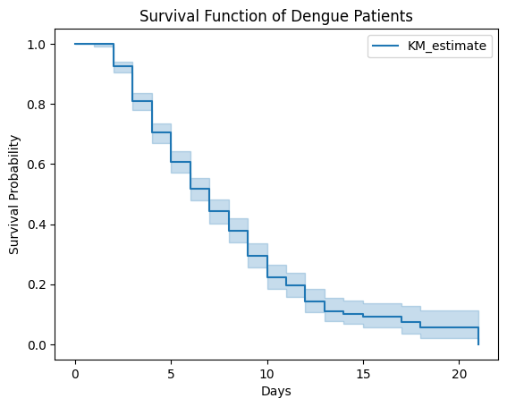
Survival Function of Dengue Patients
The plot shows the survival function of dengue patients, which is the probability of a patient surviving for a given number of days without getting dengue. The x-axis of the plot is in days and the y-axis is the survival probability.
In the plot, the y-axis starts at 1 and decreases over time, which means that the probability of a patient surviving without getting dengue decreases over time. This is because some patients will contract dengue as time goes on.

Slide 11
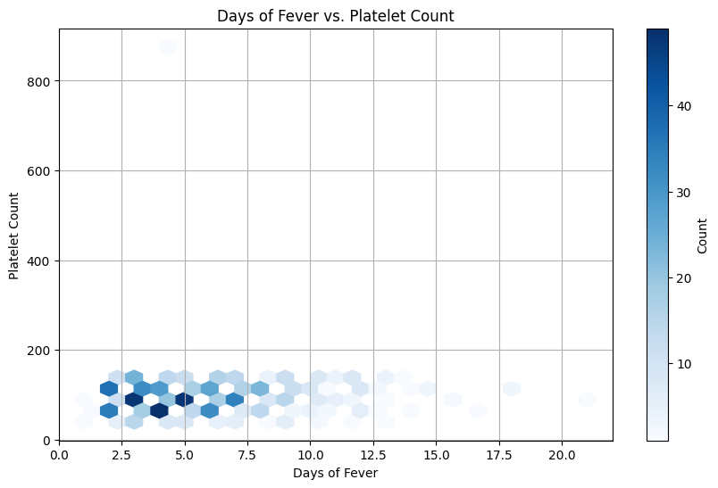
Days of Fever vs. Platelet Count
There is a dark blue colored hexagon in the lower right portion of the graph. This indicates that there were a relatively high number of patients with a high number of days of fever and a low platelet count. This is consistent with the fact that dengue fever can cause a decrease in platelet count.
Overall, the hexbin plot suggests that there is a negative correlation between the number of days of fever and platelet count in dengue patients. This means that as the number of days of fever increases, the platelet count tends to decrease.

Slide 12
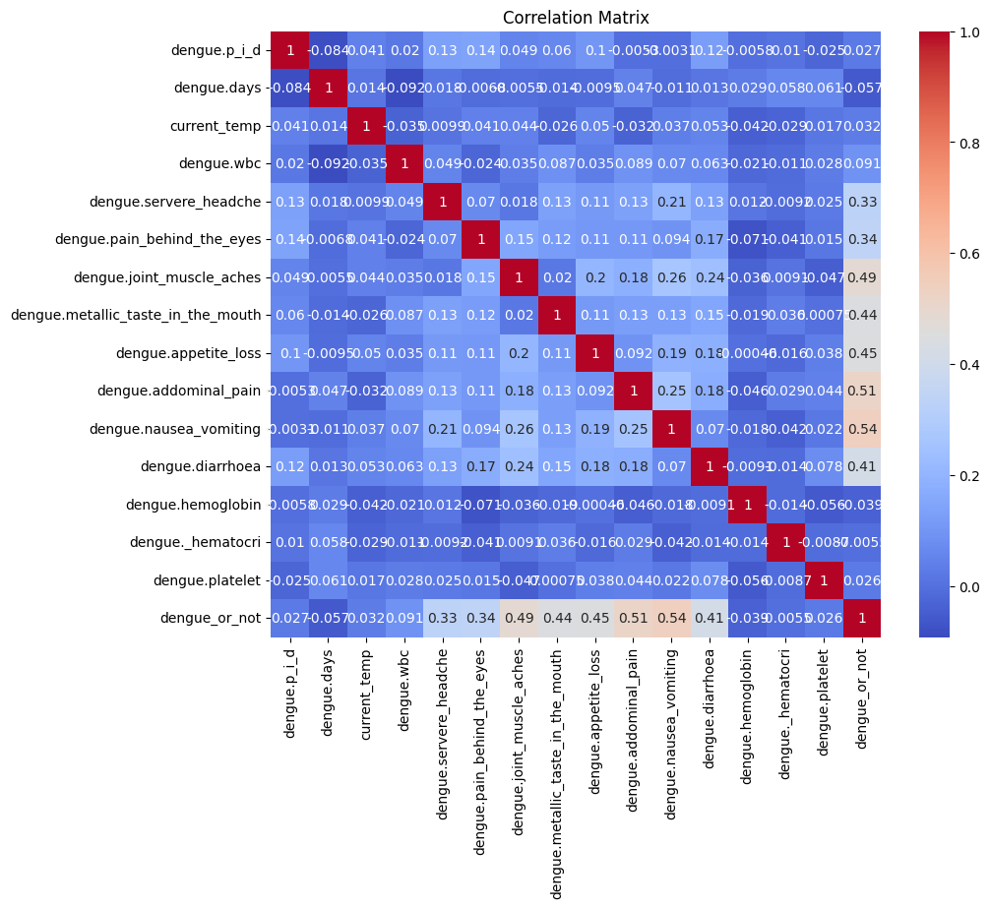
Symptom Correlation Matrix
The color of the heatmap cell indicates the strength and direction of the correlation. A yellow color indicates a negative correlation. A darker color indicates a stronger correlation.
The heatmap suggests that some symptoms, like nausea and vomiting, have a weak positive correlation with having dengue, while other symptoms, like severe headache, have a stronger positive correlation with having dengue.
Severe headache has the strongest positive correlation with having dengue, with a correlation coefficient of 0.54.
Metallic taste in the mouth has the weakest correlation with having dengue, with a correlation coefficient of 0.02.

Slide 13
03.
Machine Learning
Let’s predict dengue fever.

Slide 14
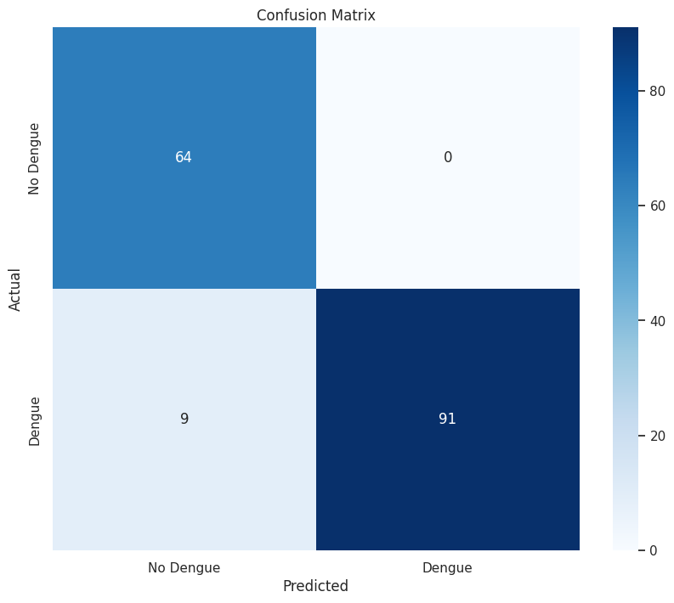
Feature Selection & Model Evaluation
Technique Used: Recursive Feature Elimination (RFE)
Process:
Preprocessing pipeline with StandardScaler and OneHotEncoder
Logistic Regression model for feature selection
Selected Features: The top 5 features selected by RFE
dengue.metallic_taste_in_the_mouth,
dengue.appetite_loss,
dengue.addominal_pain,
dengue.nausea_vomiting,
dengue.dwelling place _Bangalore
Accuracy: 0.9451219512195121
Precision: 1.0
Recall: 0.91
F1 Score: 0.9528795811518325

Slide 15
Classification Report
 | precision | recall | f1-score | support
0 | 0.88 | 1.00 | .93 | 64
1 | 1.00 | 0.91 | 0.95 | 100
ACCURACY |  |  | 0.95 | 164
MACRO AVG | .94 | .96 | .94 | 164
WEIGHTED AVG | .95 | .95 | .95 | 165

Slide 16
Conclusion and Future Work

Slide 17
Key Findings and Model Performance:
Symptoms Analysis: Our analysis revealed significant differences in the presence of certain symptoms between dengue-positive and dengue-negative cases. Symptoms like severe headache, pain behind the eyes, and joint/muscle aches were more prevalent in dengue-positive patients.
Predictive Modeling: Using a logistic regression model with Recursive Feature Elimination (RFE) for feature selection, we identified the top 5 most predictive features for dengue diagnosis. The model achieved an accuracy of 95%, precision of 100%, recall of 91%, and an F1 score of 95%. These metrics demonstrate the potential of using machine learning for early dengue detection.
Data-Driven Insights: The correlation heatmap and other visualizations underscored the importance of data-driven approaches in understanding disease patterns and enhancing predictive accuracy.

Slide 18
Future Work
Critical Explore more advanced machine learning models (e.g., Random Forest, SVM)
Collect and integrate more data for improved accuracy
Implement the model in a real-world application for early dengue detection

Slide 19
Thanks!

